Slide 1

PARTIAL PROJECT IS-2
SPRINT-1
GROUP # 4

Slide 2

ABOUT THE PROJECT
Client: Alameda
Project scope adjusted for COVID-19.
Three products.
Scrum Methodology.

Slide 3

CLIENT: ALAMEDA
“Alameda del Río” is a private urbanization in Guayaquil. The client is the president of Alameda (Eng. Pedro Xavier Gavilanez Chiriboga).

Slide 4
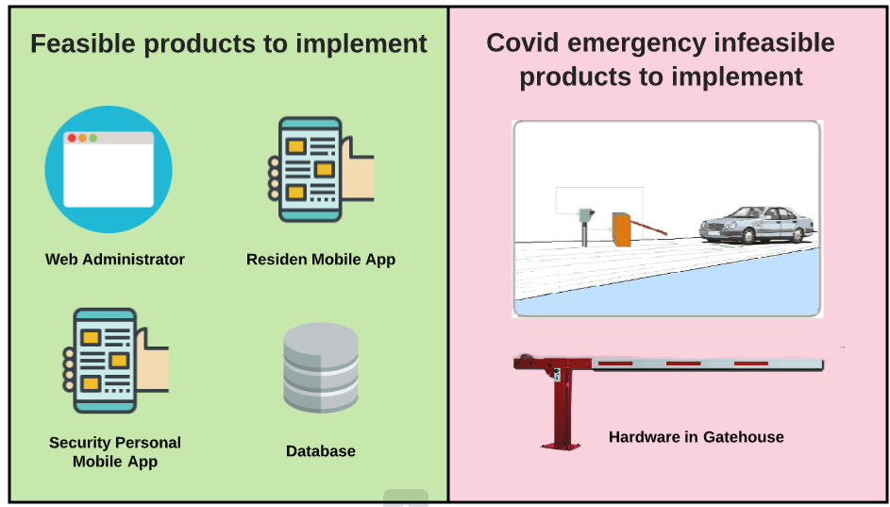
PROJECT SCOPE: FEASIBLE VS INFEASIBLE

Slide 5
WHAT WE ARE WORKING ON
WEB ADMINISTRATOR
RESIDENT APP
SECURITY STAFF APP

Slide 6
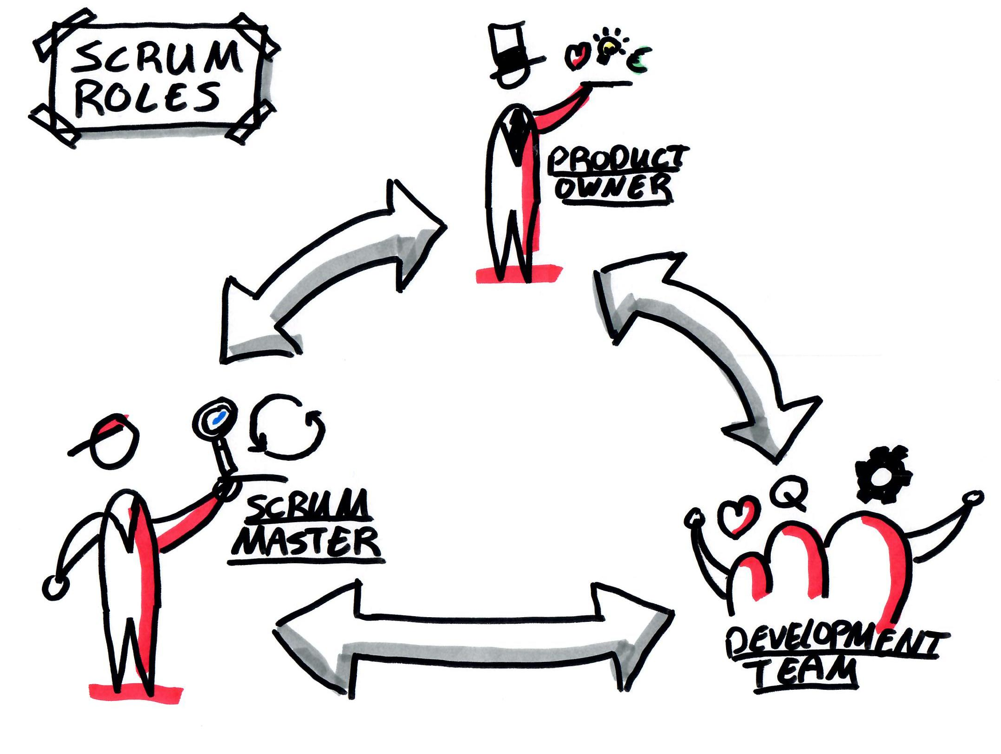
Guillermo Bernal
Karen Bermudez
Eduardo Ortiz
Hugo Won
Oswaldo Aguilar

Slide 7
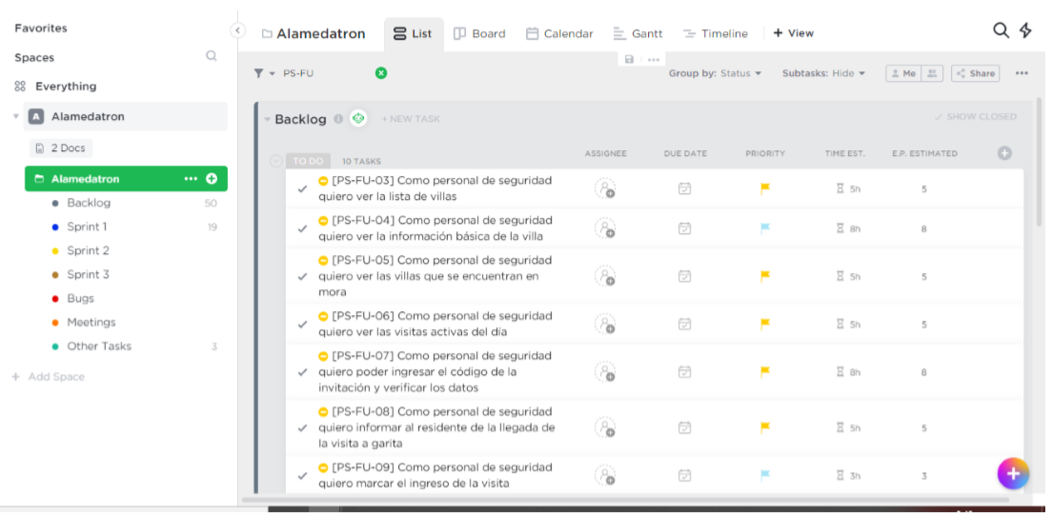

PROJECT CONTROL

Slide 8

CODE CONTROL
Documentation: https://github.com/Oswagui/-Documentation-openneighborhood-
Web – Frontend: https://github.com/Bernix01/open-neighborhood
Web - Backend: https://github.com/Bernix01/open-neighborhood-backend
Security Staff Mobile App: https://github.com/Bernix01/open-neighborhood-appsecurity
Resident Mobile App: https://github.com/Bernix01/open-neighborhood-appresident

Slide 9


WEB ADMINISTRATOR PROGRAMING LANGUAGES
FRONT
BACK

Slide 10



OTHERS WEB TOOLS/TECHNOLOGY

Slide 11


CODING STANDARDS TOOLS/TECHNOLOGY

Slide 12

TEST CASES TOOLS/TECHNOLOGY

Slide 13

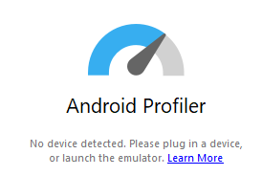
TEST CASES TOOLS/TECHNOLOGY

Slide 14


SERVER TOOLS/TECHNOLOGY

Slide 15
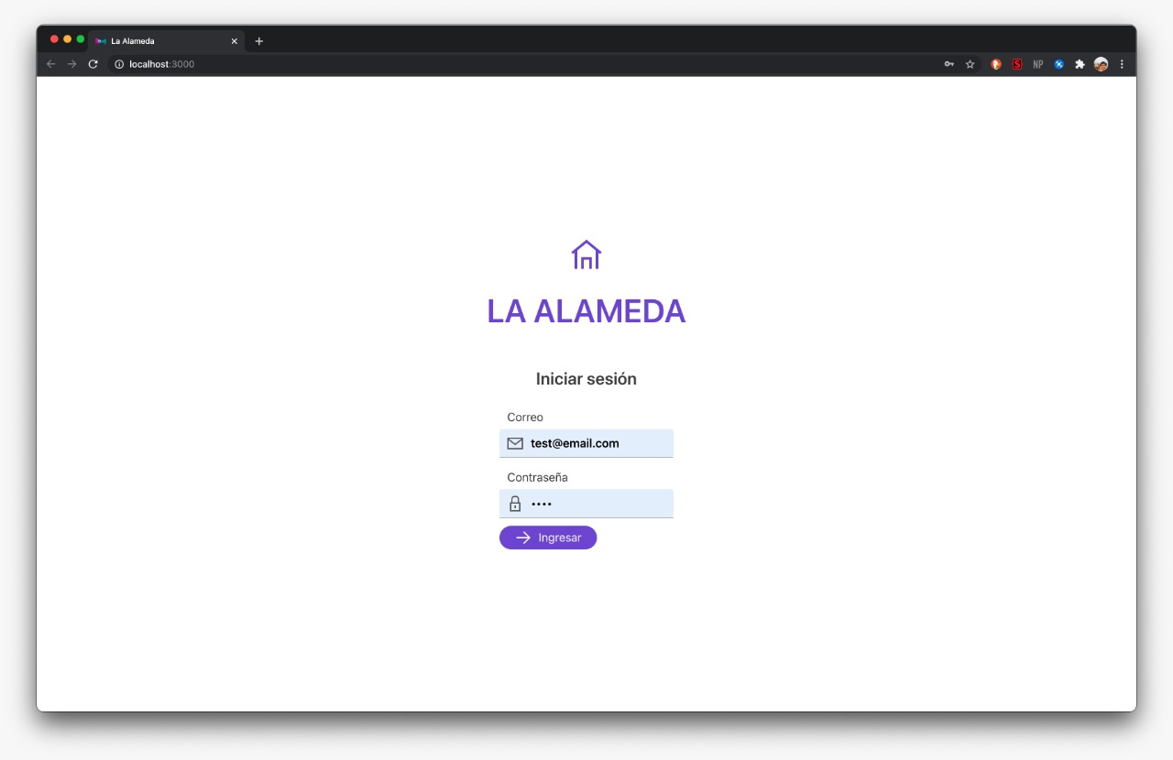
APPS

Slide 16
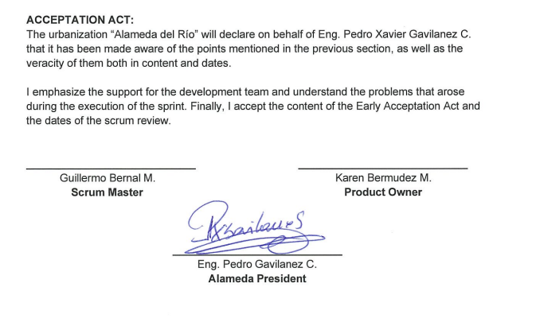
ACCEPTANCE ACT - SIGNED

